Slide 1

VE496 Advanced Technical Communication
Week 10, Day 2:
Methods and Procedures
Nathaniel T. Murray 莫子禅
Summer 2020

Slide 2
Guidelines for Structuring a Proposal
Make sure you propose a specific solution (i.e. a device or a system) to address the stated problem. Proposing to “look for a solution” will not do. A proposal is not for thinking of what to do. A proposal is for thinking of how to implement a solution you have already thought of. The funding agency will only give you their money if they see that you have already thought of a feasible solution, and you have realistic step-by-step procedures for building it.
Make sure the tools, materials, and personnel are a logical choice for the device or system you are proposing to build. Make sure your list of materials is complete and does not leave anything out.
Make sure your methods and procedures makes use of all the tools, materials, and personnel you have listed. Do not mention anything that was not previously listed in the “Materials” section.
Make sure your deliverables include not only the system or device you are proposing, but also the ways you will train people to use that device, and the ways you will disseminate information about your device to the wider industry.

Slide 3
Materials
Physical materials
Tools and equipment you will use to build the device
Parts, components, and materials of the device you will build
Electronic resources
General software: office and image processing suites
Specialized software: programming or application development packages
Supports
Power and ethernet cables
Security and encryption software
Printing, telephone, and internet services

Slide 4
Methods and Procedures: Writing Guidelines
Decide when active or passive voice is most suitable
Once we have created a new version of the website, we should user-test it with our customers and salespeople. Perhaps we could pay some of our customers to try out the site and show us where it could be improved … At the end of this process, we should have a fully functioning website. Thresholding was applied to the images that converted grayscale input images to binary images. The binarized image has only 0 (black) and 1 (white). Next, the bit edge, represented by the change of white and black pixels, was characterized and plotted in graphs.
Break down the procedure into major and minor steps, from section-level to sentence-level
Section-level: Design of Knee Brace Design of Control System Design and Development of Prototype Experimental Setup Results | Sentence-level: After the initial design has been drafted, the knee brace will be subjected to finite element analysis (FEA) using the Solidworks tool. There will be two main types of FEA analysis: (1) linear static stress analysis and (2) thermal stress analysis of parts and assemblies. The main reason for this analysis is to check for maximum displacement and contact stress.
Sources: Various

Slide 5
Methods and Procedures: Writing Guidelines
Provide brief explanations of what purpose a procedure served
We began by modelling all features since no assumptions can be made about the relevance of any specific one. We randomly split the dataset into three stratified subsets: training, validation, and test. Training data was used to derive a set of candidate data-driven models, validation data to optimize the models, and test data to valuate the top performing model performance and net benefit.
Use precise, descriptive language (quantifying where possible)
The experiment was conducted using 40 AUT Scantool machine. It started with a minimum spindle speed of 120 rpm. In the experiment, a high speed steel (HSS) drill bit with a 3 mm diameter was used. The investigation was conducted 6 mm from the depth of the cut. All drilling tests were carried out under dry conditions and drilled continuously until wear appeared, which generally occurred after 1,000 drills.
Sources: Various

Slide 6
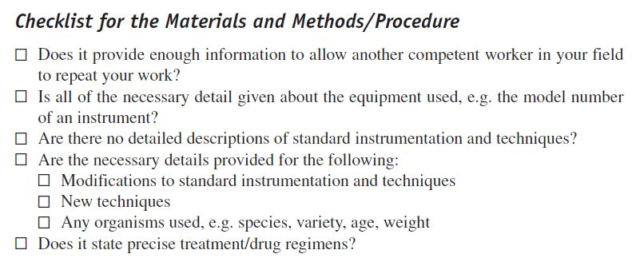
Source: Silyn-Roberts (2013)

